Slide 1
Technology Test

Slide 2






























Registered PRC trademark
21050449
It is a pleasure and an honour to be here with you today. We are looking forward to working with you and your team over the coming days.
今天我很高興和榮幸來到這裡，我期待著在未來的几天里與您和您的團隊一起工作。
Notes:
Introduction. Also an opportunity to talk a bit about Demix
Demix has LAs from across the globe and performs appraisals around the world
Demix is one of the largest CMMI services providers globally
Demix also provide other citification services, such as ISO, COBIT, MAX
It is a pleasure and honour to be here with you today. We are looking forward to work with you and your team over the coming days.
早晨好。今天我很高興和榮幸來到這裡，我期待著在未來的几天里與您和您的團隊一起工作。

Slide 3

DEMIXIUM™
Demixium™ Copyright Demix 2021
Demixium is a collection of best practices to assess an organisation across a variety of domains and best practice models. It is available for free use under the MIT free use license agreement.
Demixium 是一组最佳实践的集合，用于跨各种领域和最佳实践模型评估组织。 它可根据 MIT 免费使用许可协议免费使用。
www.demixium.com
Knowledge | Performance | Results

Slide 4
Appraisal Overview 评估概述
Notes:
Information in this section should come from the appraisal plan. The idea here is not to duplicate the contents of the plan, but to provide a summary for the Appraisal Sponsor, and the personnel from the OU who will see these findings.
The ATL may add additional information to the final findings presentation, but this minimum content must be present.

Slide 5
Appraisal Overview
Notes:
This is information that must be recorded in the appraisal plan.

Slide 6
Appraisal Overview
Notes:
This is information that must be recorded in the appraisal plan.

Slide 7
Appraisal Team and Support Personnel
Notes:
Take basic information from the appraisal plan.

Slide 8
Appraisal Principles
Start with a process framework 以一个过程框架作为开始
Observe strict confidentiality and non-attribution 严格遵循保密性和不归因性
Involve senior management as appraisal sponsor 把高层作为评估发起人
Approach appraisal collaboratively to the extent possible 评估需要协调合作进行
Focus on action 关注行动
Notes:
1, what ever you share is confidential with the ATM’s and
2, non – your name will not appear in any reports
collaboratively – we have representation from your side as well as ours last at the end there are always weaknesses and from there an improvement action is always undertaken

Slide 9
Virtual appraisals – code of conduct
When virtual interviews are planned for the appraisal, then virtual face-to-face (F2F) interviews are required to confirm the following:
Verifying interviewees are on camera
Verifying ATM identities and maximizing their participation
Verifying appraisal participant identities, e.g., interviewees, Appraisal Sponsor
Verifying only planned appraisal participants are present
Verifying that non-attribution and confidentiality rules are being followed, e.g., no other participants are present, physical setting is appropriate
Monitoring non-verbal communication and appraisal participant engagement
当计划进行虚拟面试以进行评估时，需要进行虚拟面对面（F2F）面试以确认以下内容：
确认受访者在镜头前
核实ATM身份并最大化他们的参与
核实评估参与者身份，例如，受访者，评估发起人
确认只有计划中的评估参与者在场
确认遵守了非归因和保密规则，例如，没有其他参与者在场，物理环境适当
监控非语言交流和评估参与者的参与情况

Slide 10
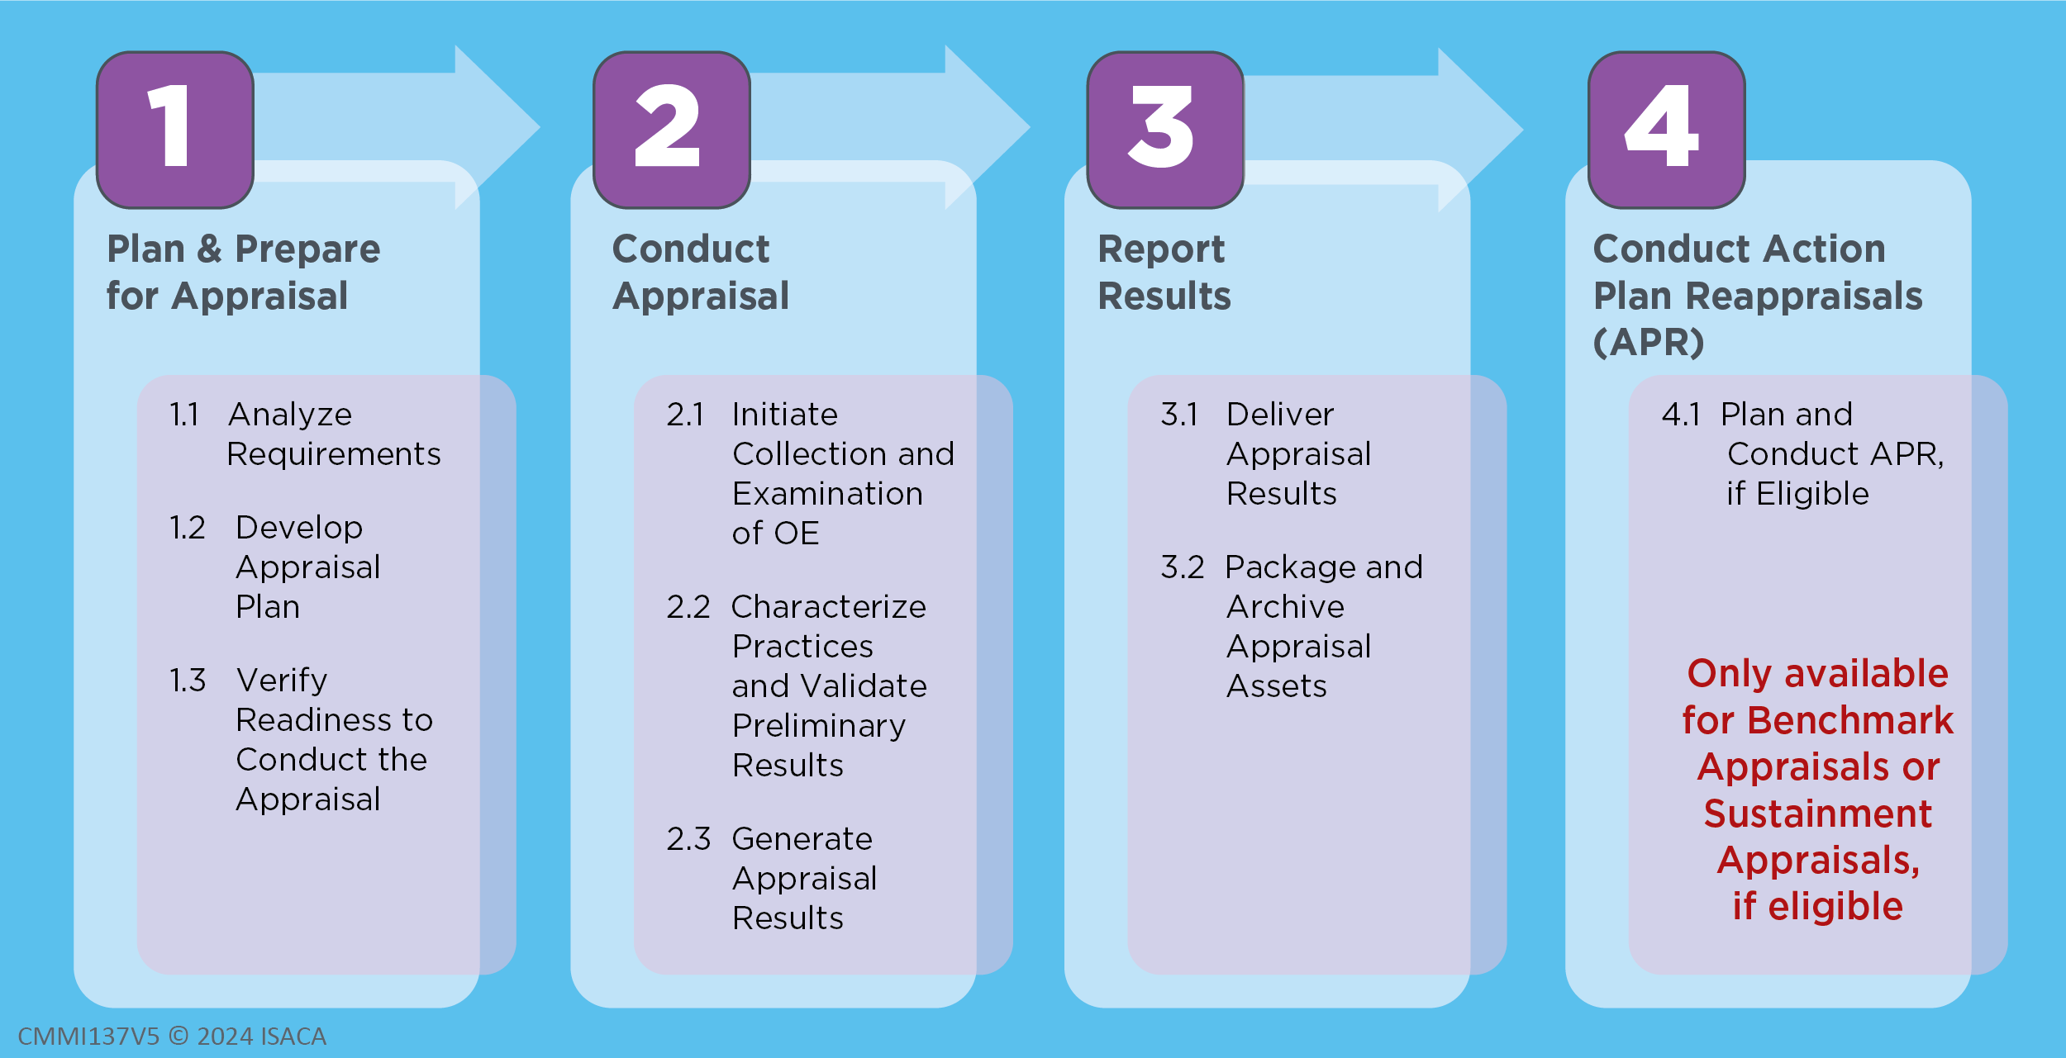
CMMI Appraisal Process – Appraisal Phases

Slide 11


Slide 12
Notice
This pptx has embedded links to 00_Data_Reference.xlsm
The latest information and version of the Benchmark Appraiser Support Environment (BASE) can be accessed at www.demix.org/tools

